Slide 1

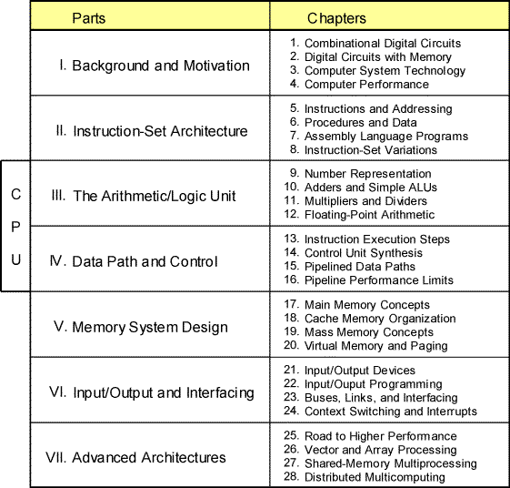
Part V
Memory System Design
Nov. 2014
Computer Architecture, Memory System Design
Slide <number>

Slide 2
About This Presentation
This presentation is intended to support the use of the textbook Computer Architecture: From Microprocessors to Supercomputers, Oxford University Press, 2005, ISBN 0-19-515455-X. It is updated regularly by the author as part of his teaching of the upper-division course ECE 154, Introduction to Computer Architecture, at the University of California, Santa Barbara. Instructors can use these slides freely in classroom teaching and for other educational purposes. Any other use is strictly prohibited. © Behrooz Parhami
Edition | Released | Revised | Revised | Revised | Revised
First | July 2003 | July 2004 | July 2005 | Mar. 2006 | Mar. 2007
 |  | Feb. 2008 | Feb. 2009 | Feb. 2011 | Nov. 2014
Nov. 2014
Computer Architecture, Memory System Design
Slide <number>

Slide 3
V Memory System Design
Design problem – We want a memory unit that:
  Can keep up with the CPU’s processing speed
  Has enough capacity for programs and data
  Is inexpensive, reliable, and energy-efficient
Topics in This Part
Chapter 17 Main Memory Concepts
Chapter 18 Cache Memory Organization
Chapter 19 Mass Memory Concepts
Chapter 20 Virtual Memory and Paging
Nov. 2014
Computer Architecture, Memory System Design
Slide <number>

Slide 4
17 Main Memory Concepts
Technologies & organizations for computer’s main memory
  SRAM (cache), DRAM (main), and flash (nonvolatile)
  Interleaving & pipelining to get around “memory wall”
Topics in This Chapter
17.1 Memory Structure and SRAM
17.2 DRAM and Refresh Cycles
17.3 Hitting the Memory Wall
17.4 Interleaved and Pipelined Memory
17.5 Nonvolatile Memory
17.6 The Need for a Memory Hierarchy
Nov. 2014
Computer Architecture, Memory System Design
Slide <number>

Slide 5
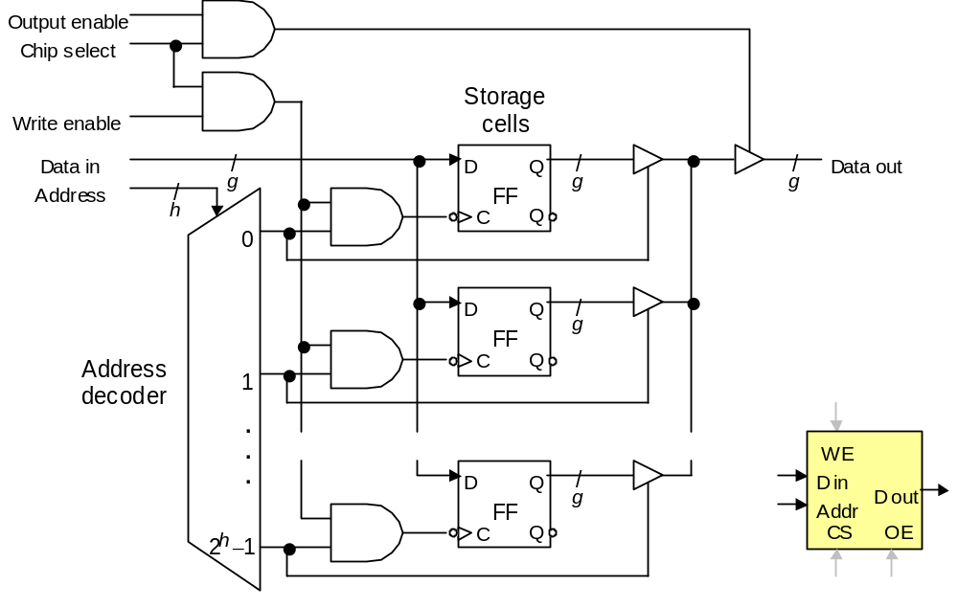
17.1 Memory Structure and SRAM
Fig. 17.1 Conceptual inner structure of a 2^{h} × g SRAM chip and its shorthand representation.
Nov. 2014
Computer Architecture, Memory System Design
Slide <number>

Slide 6
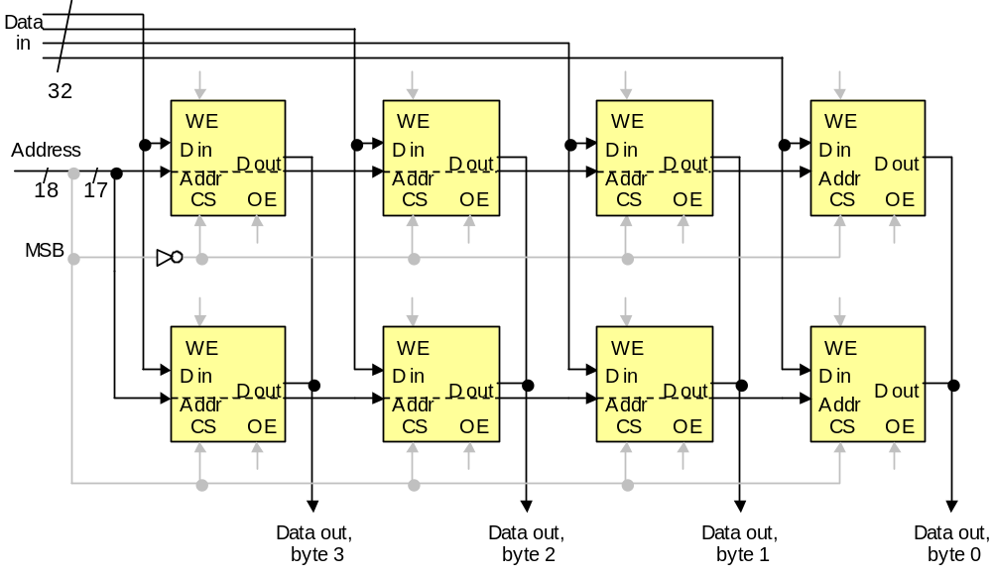
Multiple-Chip SRAM
Fig. 17.2 Eight 128K × 8 SRAM chips forming a 256K × 32 memory unit.
Nov. 2014
Computer Architecture, Memory System Design
Slide <number>

Slide 7
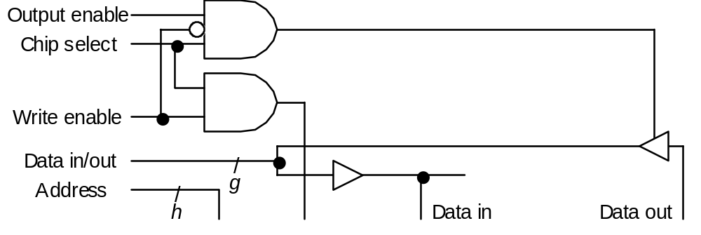
SRAM with Bidirectional Data Bus
Fig. 17.3 When data input and output of an SRAM chip are shared or connected to a bidirectional data bus, output must be disabled during write operations.
Nov. 2014
Computer Architecture, Memory System Design
Slide <number>

Slide 8
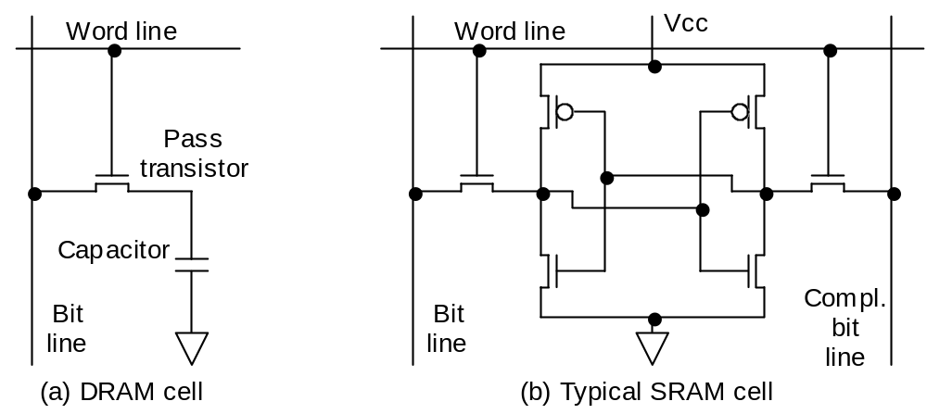
17.2 DRAM and Refresh Cycles
DRAM vs. SRAM Memory Cell Complexity
Fig. 17.4 Single-transistor DRAM cell, which is considerably simpler than SRAM cell, leads to dense, high-capacity DRAM memory chips.
Nov. 2014
Computer Architecture, Memory System Design
Slide <number>

Slide 9
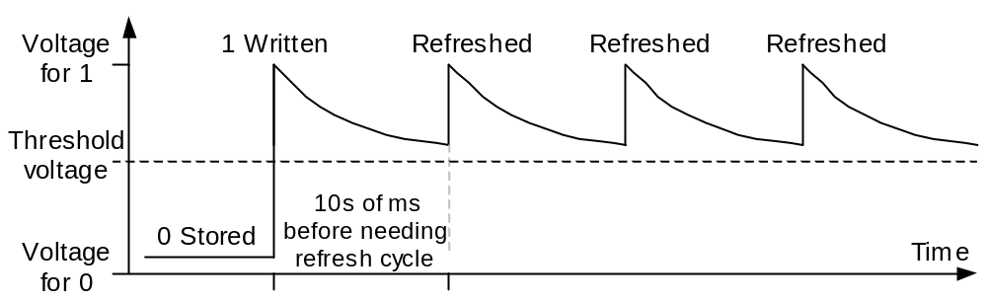
DRAM Refresh Cycles and Refresh Rate
Fig. 17.5 Variations in the voltage across a DRAM cell capacitor after writing a 1 and subsequent refresh operations.
Nov. 2014
Computer Architecture, Memory System Design
Slide <number>

Slide 10
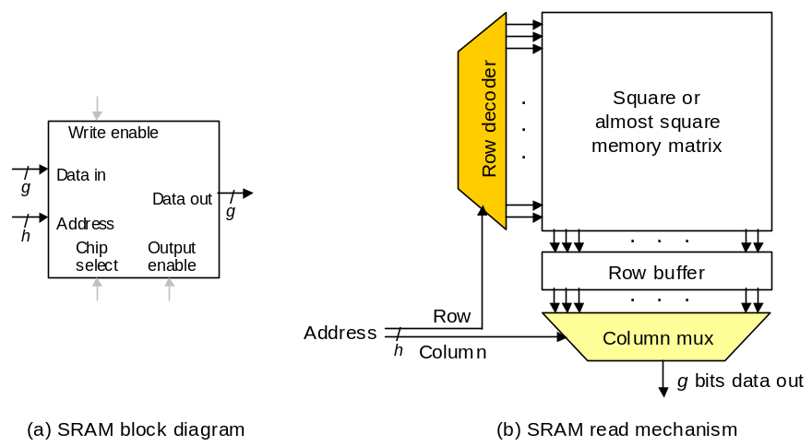
Loss of Bandwidth to Refresh Cycles
Example 17.2
A 256 Mb DRAM chip is organized as a 32M × 8 memory externally and as a 16K × 16K array internally. Rows must be refreshed at least once every 50 ms to forestall data loss; refreshing a row takes 100 ns. What fraction of the total memory bandwidth is lost to refresh cycles?
16K
16K
14
Figure 2.10
11
8
Solution
Refreshing all 16K rows takes 16 × 1024 × 100 ns = 1.64 ms. Loss of 1.64 ms every 50 ms amounts to 1.64/50 = 3.3% of the total bandwidth.
Nov. 2014
Computer Architecture, Memory System Design
Slide <number>

Slide 11
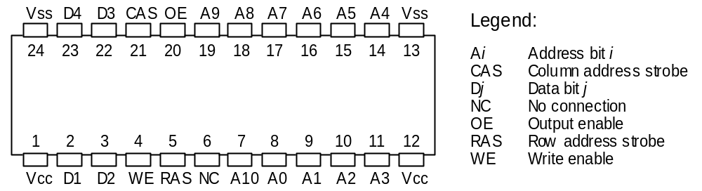
DRAM Packaging
24-pin dual in-line package (DIP)
Fig. 17.6 Typical DRAM package housing a 16M × 4 memory.
Nov. 2014
Computer Architecture, Memory System Design
Slide <number>

Slide 12
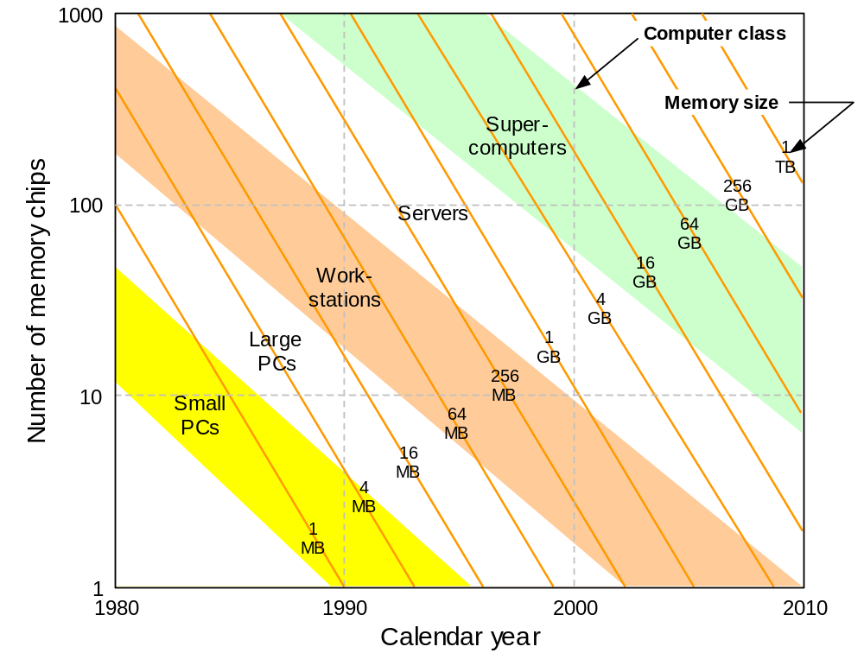
DRAM Evolution
Fig. 17.7 Trends in DRAM main memory.
Nov. 2014
Computer Architecture, Memory System Design
Slide <number>

Slide 13
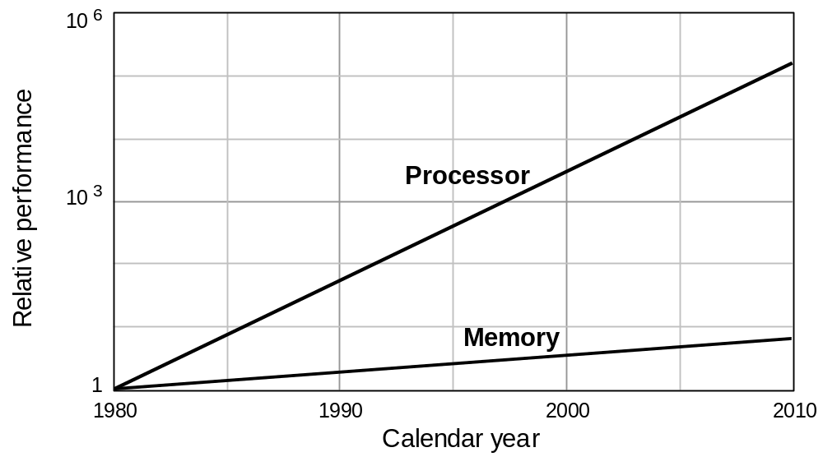
17.3 Hitting the Memory Wall
Fig. 17.8 Memory density and capacity have grown along with the CPU power and complexity, but memory speed has not kept pace.
Nov. 2014
Computer Architecture, Memory System Design
Slide <number>

Slide 14
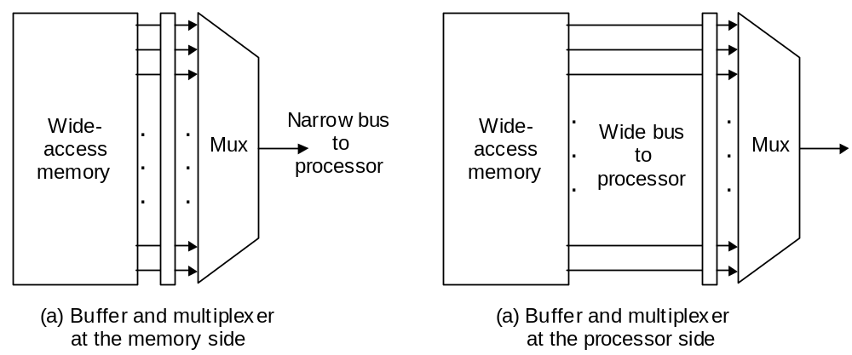
Bridging the CPU-Memory Speed Gap
Idea: Retrieve more data from memory with each access
Fig. 17.9 Two ways of using a wide-access memory to bridge the speed gap between the processor and memory.
Nov. 2014
Computer Architecture, Memory System Design
Slide <number>

Slide 15
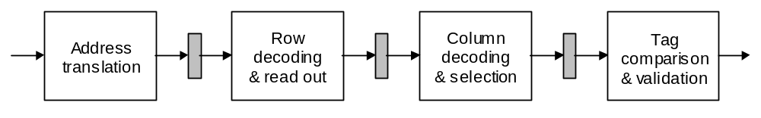
17.4 Pipelined and Interleaved Memory
Memory latency may involve other supporting operations
besides the physical access itself
Virtual-to-physical address translation (Chap 20)
Tag comparison to determine cache hit/miss (Chap 18)
Fig. 17.10 Pipelined cache memory.
Nov. 2014
Computer Architecture, Memory System Design
Slide <number>

Slide 16
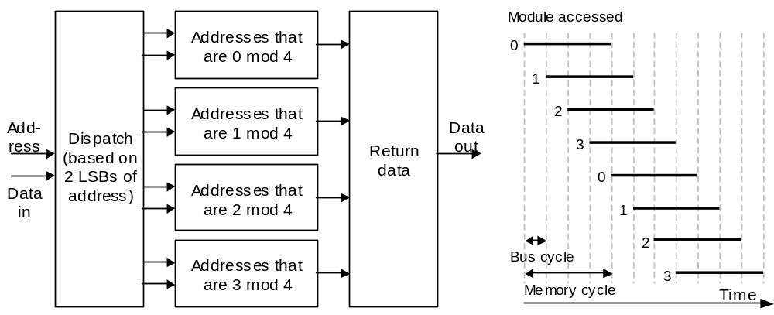
Memory Interleaving
Addresses 0, 4, 8, …
Addresses 1, 5, 9, …
Addresses 2, 6, 10, …
Addresses 3, 7, 11, …
Fig. 17.11 Interleaved memory is more flexible than wide-access memory in that it can handle multiple independent accesses at once.
Nov. 2014
Computer Architecture, Memory System Design
Slide <number>

Slide 17
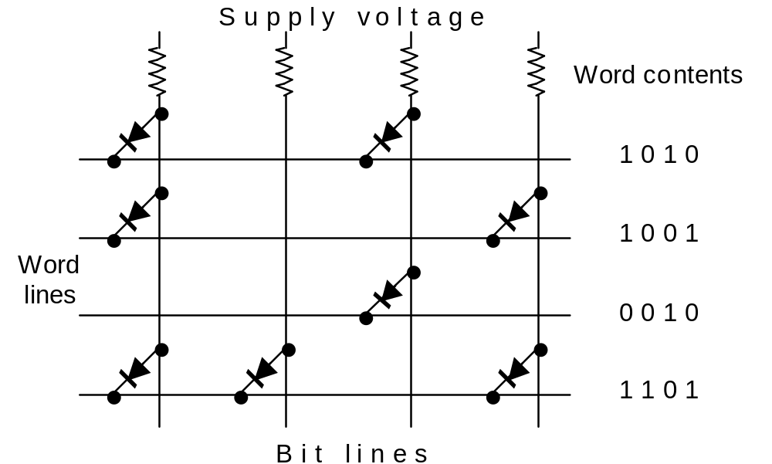
17.5 Nonvolatile Memory
ROM PROM EPROM
Fig. 17.12 Read-only memory organization, with the fixed contents shown on the right.
Nov. 2014
Computer Architecture, Memory System Design
Slide <number>

Slide 18
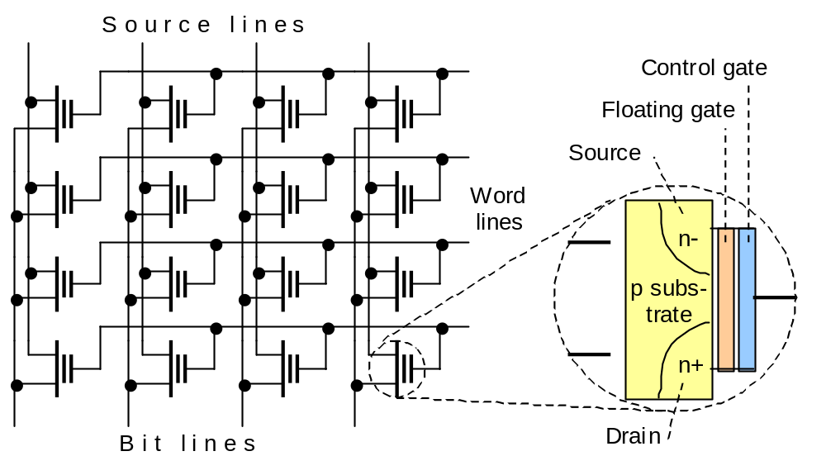
Flash Memory
Fig. 17.13 EEPROM or Flash memory organization. Each memory cell is built of a floating-gate MOS transistor.
Nov. 2014
Computer Architecture, Memory System Design
Slide <number>

Slide 19
17.6 The Need for a Memory Hierarchy
The widening speed gap between CPU and main memory
Processor operations take of the order of 1 ns
Memory access requires 10s or even 100s of ns
Memory bandwidth limits the instruction execution rate
Each instruction executed involves at least one memory access
Hence, a few to 100s of MIPS is the best that can be achieved
A fast buffer memory can help bridge the CPU-memory gap
The fastest memories are expensive and thus not very large
A second (third?) intermediate cache level is thus often used
Nov. 2014
Computer Architecture, Memory System Design
Slide <number>

Slide 20
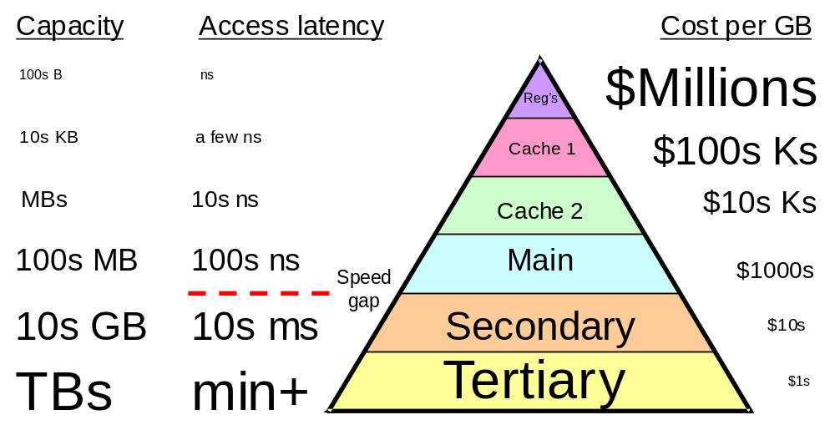
Typical Levels in a Hierarchical Memory
Fig. 17.14 Names and key characteristics of levels in a memory hierarchy.
Nov. 2014
Computer Architecture, Memory System Design
Slide <number>

Slide 21
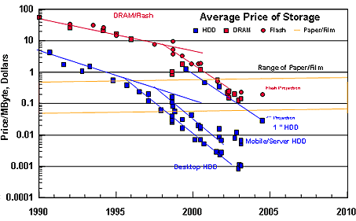
Memory Price Trends
100K
■ DRAM  Flash
10K
1K
$ / GByte
100
Hard disk drive
10
1
0.1
Source: https://www1.hitachigst.com/hdd/technolo/overview/chart03.html
Nov. 2014
Computer Architecture, Memory System Design
Slide <number>

Slide 22
18 Cache Memory Organization
Processor speed is improving at a faster rate than memory’s
  Processor-memory speed gap has been widening
  Cache is to main as desk drawer is to file cabinet
Topics in This Chapter
18.1 The Need for a Cache
18.2 What Makes a Cache Work?
18.3 Direct-Mapped Cache
18.4 Set-Associative Cache
18.5 Cache and Main Memory
18.6 Improving Cache Performance
Nov. 2014
Computer Architecture, Memory System Design
Slide <number>

Slide 23
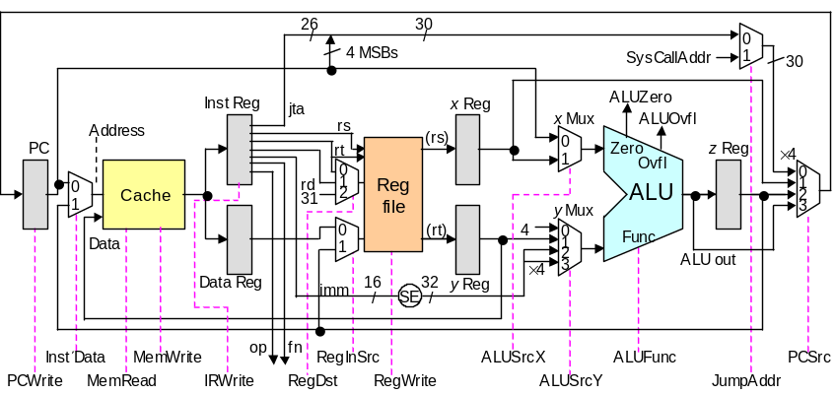
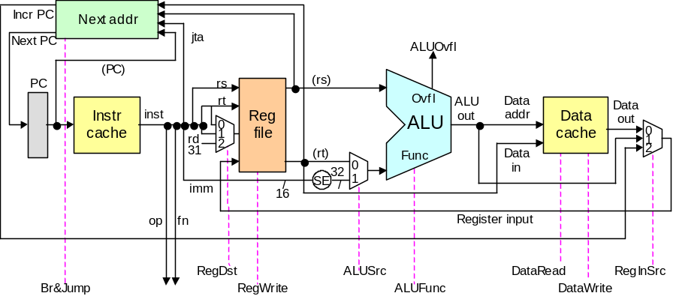
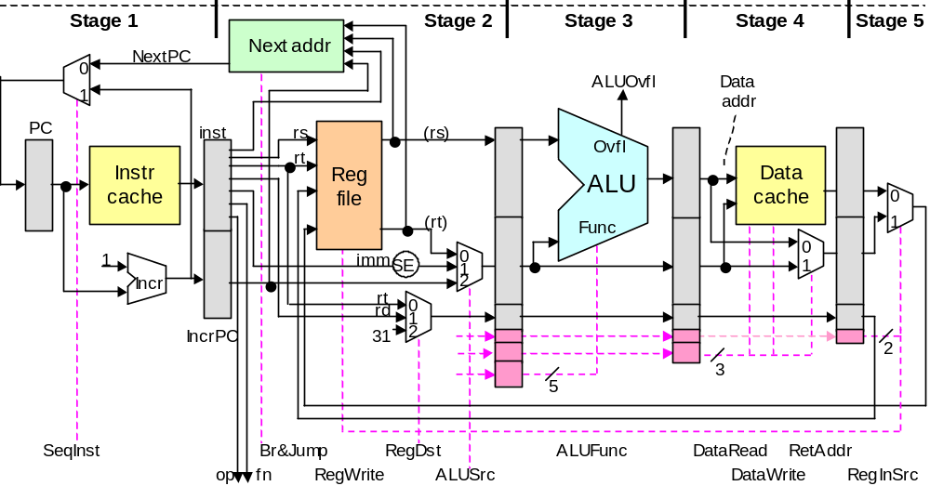
18.1 The Need for a Cache
Single-cycle
Multicycle
125 MHz
CPI = 1
500 MHz
CPI ≅ 4
All three of our MicroMIPS designs assumed 2-ns data and instruction memories; however, typical RAMs are 10-50 times slower
Pipelined
500 MHz
CPI ≅ 1.1
Nov. 2014
Computer Architecture, Memory System Design
Slide <number>

Slide 24
Cache, Hit/Miss Rate, and Effective Access Time
Cache is transparent to user;
transfers occur automatically
Main
(slow)
memory
Line
Word
Cache
(fast)
memory
CPU
Reg
file
Data is in the cache fraction h of the time
(say, hit rate of 98%)
Go to main 1 – h of the time
(say, cache miss rate of 2%)
One level of cache with hit rate h
C_{eff} = hC_{fast} + (1 – h)(C_{slow} + C_{fast}) = C_{fast} + (1 – h)C_{slow}
Nov. 2014
Computer Architecture, Memory System Design
Slide <number>

Slide 25
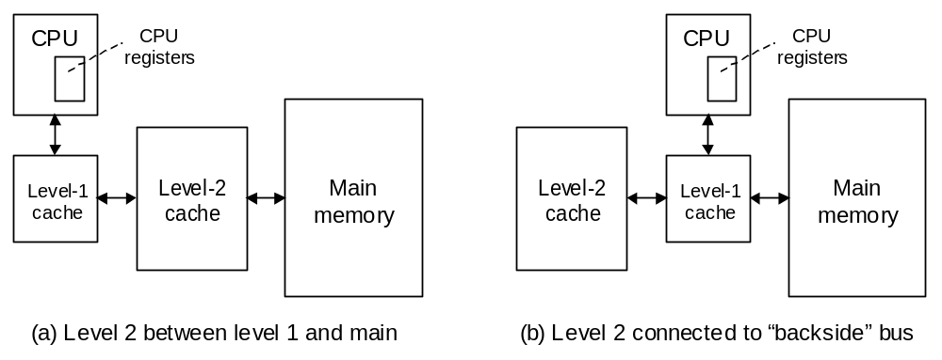
Multiple Cache Levels
Cleaner and easier to analyze
Fig. 18.1 Cache memories act as intermediaries between the superfast processor and the much slower main memory.
Nov. 2014
Computer Architecture, Memory System Design
Slide <number>

Slide 26
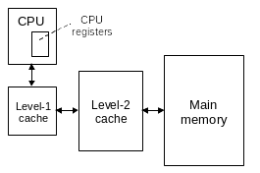
Performance of a Two-Level Cache System
Example 18.1
A system with L1 and L2 caches has a CPI of 1.2 with no cache miss. There are 1.1 memory accesses on average per instruction.
What is the effective CPI with cache misses factored in?
What are the effective hit rate and miss penalty overall if L1 and L2 caches are modeled as a single cache?
Level Local hit rate Miss penalty
L1 95 % 8 cycles
L2 80 % 60 cycles
1%
4%
95%
Solution
C_{eff} = C_{fast} + (1 – h₁)[C_{medium} + (1 – h₂)C_{slow}]
Because C_{fast} is included in the CPI of 1.2, we must account for the rest
CPI = 1.2 + 1.1(1 – 0.95)[8 + (1 – 0.8)60] = 1.2 + 1.1 × 0.05 × 20 = 2.3
Overall: hit rate 99% (95% + 80% of 5%), miss penalty 60 cycles
8 cycles
60 cycles
Nov. 2014
Computer Architecture, Memory System Design
Slide <number>

Slide 27
Cache Memory Design Parameters
Cache size (in bytes or words). A larger cache can hold more of the program’s useful data but is more costly and likely to be slower.
Block or cache-line size (unit of data transfer between cache and main). With a larger cache line, more data is brought in cache with each miss. This can improve the hit rate but also may bring low-utility data in.
Placement policy. Determining where an incoming cache line is stored. More flexible policies imply higher hardware cost and may or may not have performance benefits (due to more complex data location).
Replacement policy. Determining which of several existing cache blocks (into which a new cache line can be mapped) should be overwritten. Typical policies: choosing a random or the least recently used block.
Write policy. Determining if updates to cache words are immediately forwarded to main (write-through) or modified blocks are copied back to main if and when they must be replaced (write-back or copy-back).
Nov. 2014
Computer Architecture, Memory System Design
Slide <number>

Slide 28
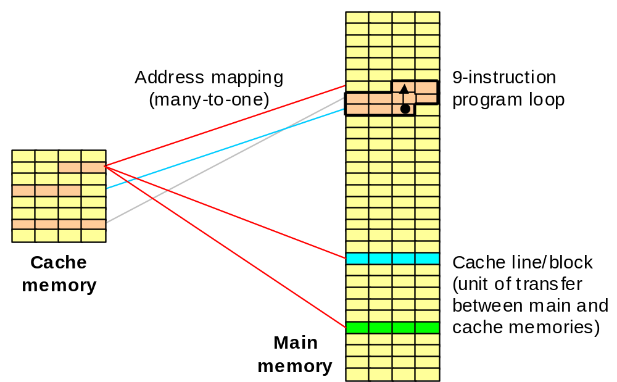
18.2 What Makes a Cache Work?
Temporal locality
Spatial locality
Fig. 18.2 Assuming no conflict in address mapping, the cache will hold a small program loop in its entirety, leading to fast execution.
Nov. 2014
Computer Architecture, Memory System Design
Slide <number>

Slide 29
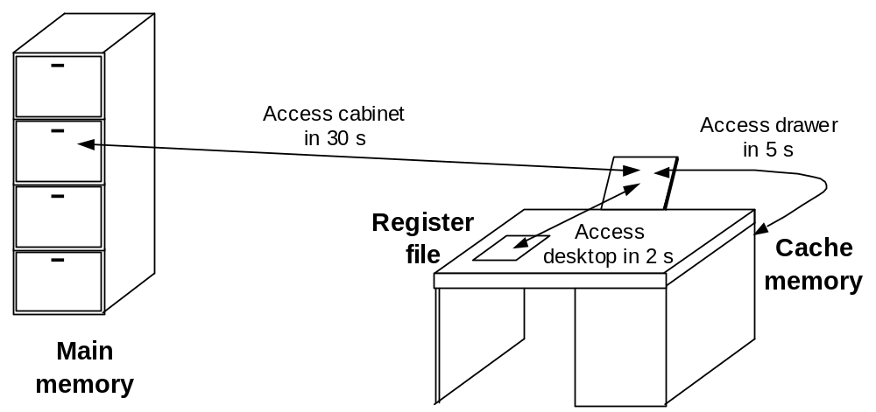
Desktop, Drawer, and File Cabinet Analogy
Once the “working set” is in the drawer, very few trips to the file cabinet are needed.
Fig. 18.3 Items on a desktop (register) or in a drawer (cache) are more readily accessible than those in a file cabinet (main memory).
Nov. 2014
Computer Architecture, Memory System Design
Slide <number>

Slide 30
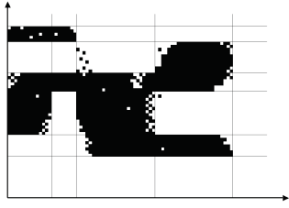
Temporal and Spatial Localities
Addresses
From Peter Denning’s CACM paper, July 2005 (Vol. 48, No. 7, pp. 19-24)
Temporal:
Accesses to the same address are typically clustered in time
Spatial:
When a location is accessed, nearby locations tend to be accessed also
Working set
Time
Nov. 2014
Computer Architecture, Memory System Design
Slide <number>

Slide 31
Caching Benefits Related to Amdahl’s Law
Example 18.2
In the drawer & file cabinet analogy, assume a hit rate h in the drawer. Formulate the situation shown in Fig. 18.2 in terms of Amdahl’s law.
Solution
Without the drawer, a document is accessed in 30 s. So, fetching 1000 documents, say, would take 30 000 s. The drawer causes a fraction h of the cases to be done 6 times as fast, with access time unchanged for the remaining 1 – h. Speedup is thus 1/(1 – h + h/6) = 6 / (6 – 5h). Improving the drawer access time can increase the speedup factor but as long as the miss rate remains at 1 – h, the speedup can never exceed 1 / (1 – h). Given h = 0.9, for instance, the speedup is 4, with the upper bound being 10 for an extremely short drawer access time.
Note: Some would place everything on their desktop, thinking that this yields even greater speedup. This strategy is not recommended!
3
Nov. 2014
Computer Architecture, Memory System Design
Slide <number>

Slide 32
Compulsory, Capacity, and Conflict Misses
Compulsory misses: With on-demand fetching, first access to any item is a miss. Some “compulsory” misses can be avoided by prefetching.
Capacity misses: We have to oust some items to make room for others. This leads to misses that are not incurred with an infinitely large cache.
Conflict misses: Occasionally, there is free room, or space occupied by useless data, but the mapping/placement scheme forces us to displace useful items to bring in other items. This may lead to misses in future.
Given a fixed-size cache, dictated, e.g., by cost factors or availability of space on the processor chip, compulsory and capacity misses are pretty much fixed. Conflict misses, on the other hand, are influenced by the data mapping scheme which is under our control.
We study two popular mapping schemes: direct and set-associative.
Nov. 2014
Computer Architecture, Memory System Design
Slide <number>

Slide 33
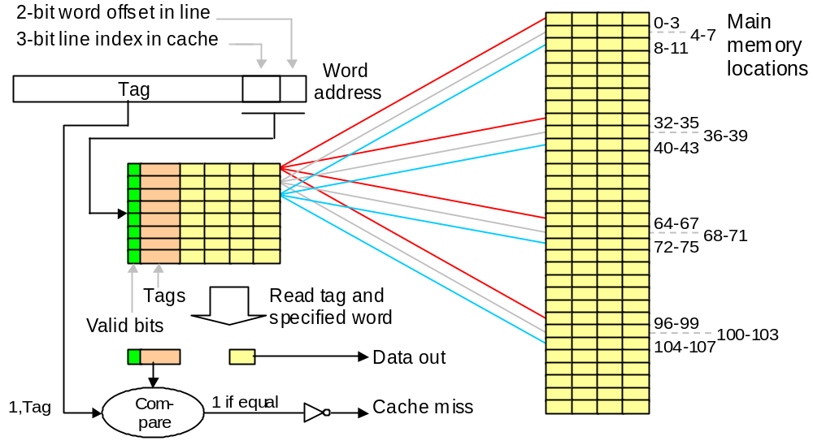
18.3 Direct-Mapped Cache
Fig. 18.4 Direct-mapped cache holding 32 words within eight 4-word lines. Each line is associated with a tag and a valid bit.
Nov. 2014
Computer Architecture, Memory System Design
Slide <number>

Slide 34
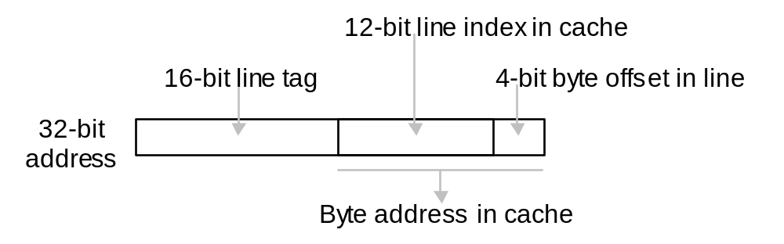
Accessing a Direct-Mapped Cache
Example 18.4
Show cache addressing for a byte-addressable memory with 32-bit
addresses. Cache line W = 16 B. Cache size L = 4096 lines (64 KB).
Solution
Byte offset in line is log₂16 = 4 b. Cache line index is log₂4096 = 12 b.
This leaves 32 – 12 – 4 = 16 b for the tag.
Fig. 18.5 Components of the 32-bit address in an example direct-mapped cache with byte addressing.
Nov. 2014
Computer Architecture, Memory System Design
Slide <number>

Slide 35
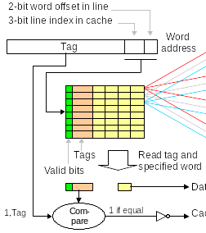
Direct-Mapped
Cache Behavior
Fig. 18.4
Address trace:
1, 7, 6, 5, 32, 33, 1, 2, . . .
1: miss, line 3, 2, 1, 0 fetched
7: miss, line 7, 6, 5, 4 fetched
6: hit
5: hit
32: miss, line 35, 34, 33, 32 fetched
(replaces 3, 2, 1, 0)
33: hit
1: miss, line 3, 2, 1, 0 fetched
(replaces 35, 34, 33, 32)
2: hit
... and so on
35
3
3
34
2
2
33
1
1
32
0
0
7
6
5
4
Nov. 2014
Computer Architecture, Memory System Design
Slide <number>

Slide 36
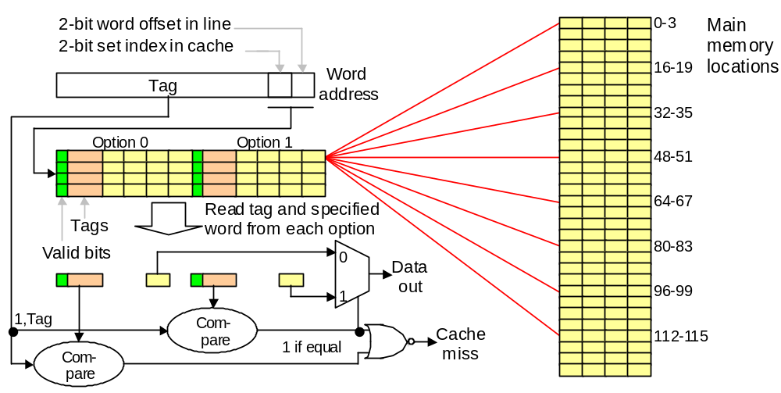
18.4 Set-Associative Cache
Fig. 18.6 Two-way set-associative cache holding 32 words of data within 4-word lines and 2-line sets.
Nov. 2014
Computer Architecture, Memory System Design
Slide <number>

Slide 37
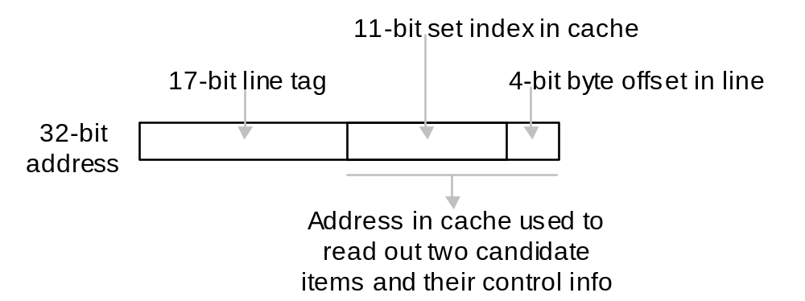
Accessing a Set-Associative Cache
Example 18.5
Show cache addressing scheme for a byte-addressable memory with
32-bit addresses. Cache line width 2^{W} = 16 B. Set size 2^{S} = 2 lines.
Cache size 2^{L} = 4096 lines (64 KB).
Solution
Byte offset in line is log₂16 = 4 b. Cache set index is (log₂4096/2) = 11 b.
This leaves 32 – 11 – 4 = 17 b for the tag.
Fig. 18.7 Components of the 32-bit address in an example two-way set-associative cache.
Nov. 2014
Computer Architecture, Memory System Design
Slide <number>

Slide 38
Cache Address Mapping
Example 18.6
A 64 KB four-way set-associative cache is byte-addressable and
contains 32 B lines. Memory addresses are 32 b wide.
a. How wide are the tags in this cache?
b. Which main memory addresses are mapped to set number 5?
Solution
a. Address (32 b) = 5 b byte offset + 9 b set index + 18 b tag
b. Addresses that have their 9-bit set index equal to 5. These are of the general form 2¹⁴a + 2⁵×5 + b; e.g., 160-191, 16 554-16 575, . . .
32-bit
address
Tag
Set index
Offset
18 bits
9 bits
5 bits
Tag width =
32 – 5 – 9 = 18
Set size = 4 × 32 B = 128 B
Number of sets = 2¹⁶/2⁷ = 2⁹
Line width =
32 B = 2⁵ B
Nov. 2014
Computer Architecture, Memory System Design
Slide <number>

Slide 39
18.5 Cache and Main Memory
Split cache: separate instruction and data caches (L1)
Unified cache: holds instructions and data (L1, L2, L3)
Harvard architecture: separate instruction and data memories
von Neumann architecture: one memory for instructions and data
The writing problem:
Write-through slows down the cache to allow main to catch up
Write-back or copy-back is less problematic, but still hurts performance due to two main memory accesses in some cases.
Solution: Provide write buffers for the cache so that it does not have to wait for main memory to catch up.
Nov. 2014
Computer Architecture, Memory System Design
Slide <number>

Slide 40
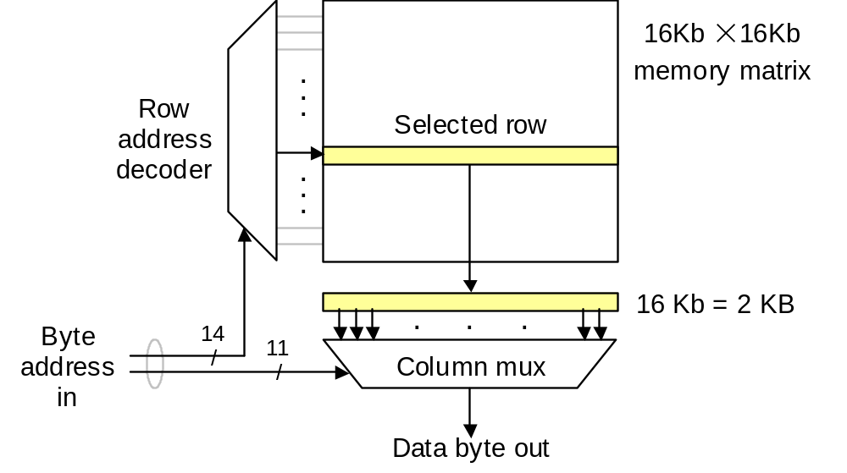
Faster Main-Cache Data Transfers
Fig. 18.8 A 256 Mb DRAM chip organized as a 32M × 8 memory module: four such chips could form a 128 MB main memory unit.
Nov. 2014
Computer Architecture, Memory System Design
Slide <number>

Slide 41
18.6 Improving Cache Performance
For a given cache size, the following design issues and tradeoffs exist:
Line width (2^{W}). Too small a value for W causes a lot of main memory accesses; too large a value increases the miss penalty and may tie up cache space with low-utility items that are replaced before being used.
Set size or associativity (2^{S}). Direct mapping (S = 0) is simple and fast; greater associativity leads to more complexity, and thus slower access, but tends to reduce conflict misses. More on this later.
Line replacement policy. Usually LRU (least recently used) algorithm or some approximation thereof; not an issue for direct-mapped caches. Somewhat surprisingly, random selection works quite well in practice.
Write policy. Modern caches are very fast, so that write-through is seldom a good choice. We usually implement write-back or copy-back, using write buffers to soften the impact of main memory latency.
Nov. 2014
Computer Architecture, Memory System Design
Slide <number>

Slide 42
Effect of Line Width on Cache Performance
0.3
0.2
Miss rate
64 KB
0.1
128 KB
256 KB
0.0
8
16
32
64
128
256
512
Line width in bytes
Variation of cache performance as a function of line size.
Nov. 2014
Computer Architecture, Memory System Design
Slide <number>

Slide 43
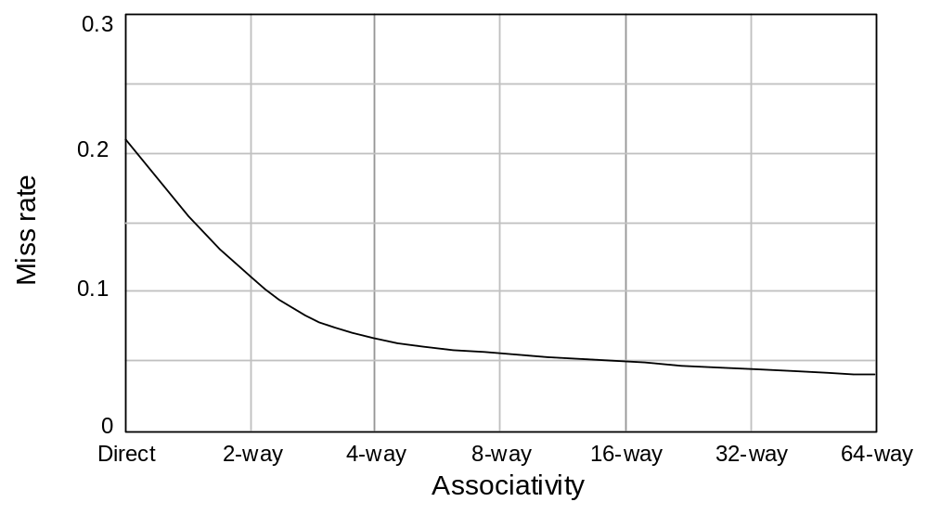
Effect of Associativity on Cache Performance
Fig. 18.9 Performance improvement of caches with increased associativity.
Nov. 2014
Computer Architecture, Memory System Design
Slide <number>

Slide 44
19 Mass Memory Concepts
Today’s main memory is huge, but still inadequate for all needs
  Magnetic disks provide extended and back-up storage
  Optical disks & disk arrays are other mass storage options
Topics in This Chapter
19.1 Disk Memory Basics
19.2 Organizing Data on Disk
19.3 Disk Performance
19.4 Disk Caching
19.5 Disk Arrays and RAID
19.6 Other Types of Mass Memory
Nov. 2014
Computer Architecture, Memory System Design
Slide <number>

Slide 45
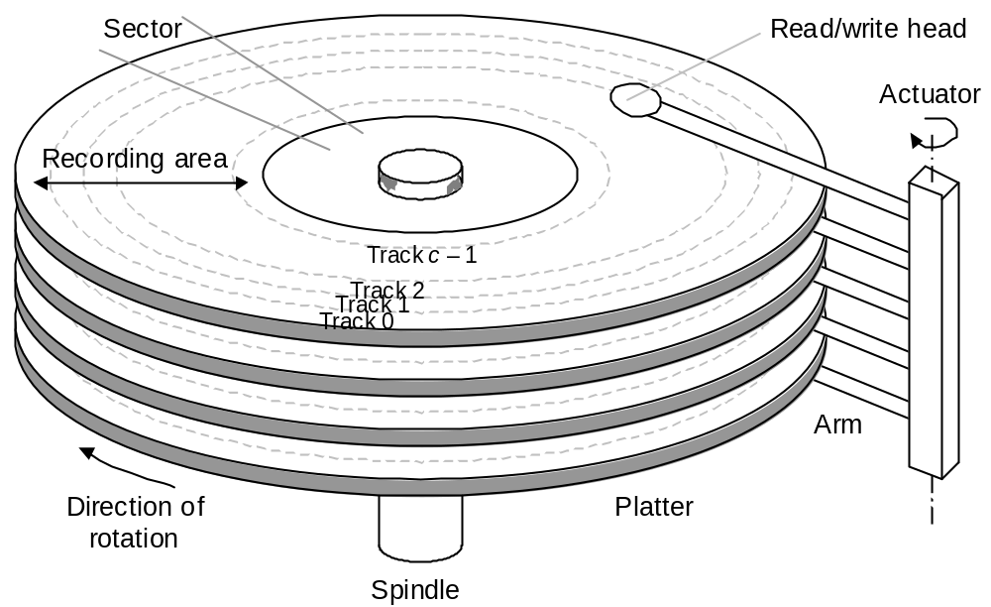
19.1 Disk Memory Basics
Fig. 19.1 Disk memory elements and key terms.
Nov. 2014
Computer Architecture, Memory System Design
Slide <number>

Slide 46
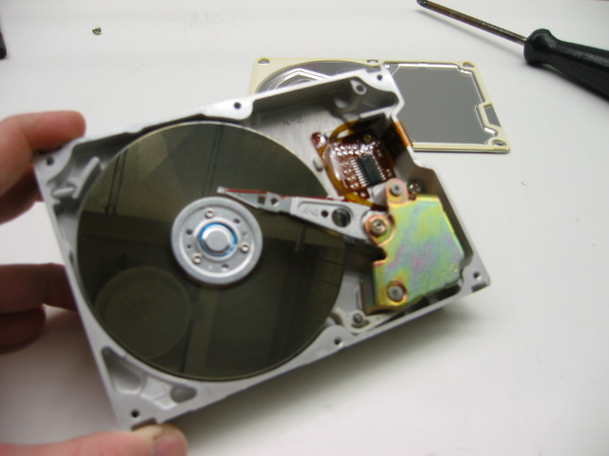
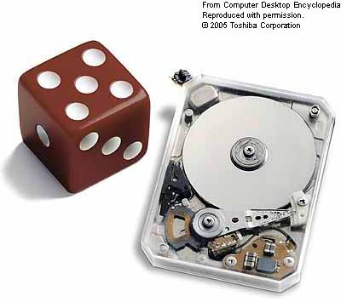
Disk Drives
Typically
2-8 cm
Typically
2
-
8 cm
Nov. 2014
Computer Architecture, Memory System Design
Slide <number>

Slide 47
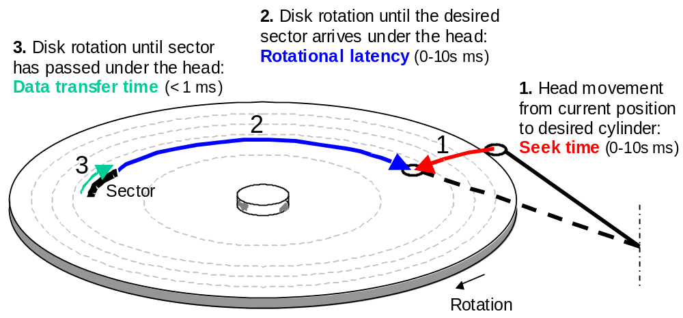
Access Time for a Disk
The three components of disk access time. Disks that spin faster have a shorter average and worst-case access time.
Nov. 2014
Computer Architecture, Memory System Design
Slide <number>

Slide 48
Representative Magnetic Disks
Table 19.1 Key attributes of three representative magnetic disks, from the highest capacity to the smallest physical size (ca. early 2003). [More detail (weight, dimensions, recording density, etc.) in textbook.]
Manufacturer and Model Name | Seagate Barracuda 180 | Hitachi DK23DA | IBM Microdrive
Application domain | Server | Laptop | Pocket device
Capacity | 180 GB | 40 GB | 1 GB
Platters / Surfaces | 12 / 24 | 2 / 4 | 1 / 2
Cylinders | 24 247 | 33 067 | 7 167
Sectors per track, avg | 604 | 591 | 140
Buffer size | 16 MB | 2 MB | 1/8 MB
Seek time, min,avg,max | 1, 8, 17 ms | 3, 13, 25 ms | 1, 12, 19 ms
Diameter | 3.5″ | 2.5″ | 1.0″
Rotation speed, rpm | 7 200 | 4 200 | 3 600
Typical power | 14.1 W | 2.3 W | 0.8 W
Nov. 2014
Computer Architecture, Memory System Design
Slide <number>

Slide 49
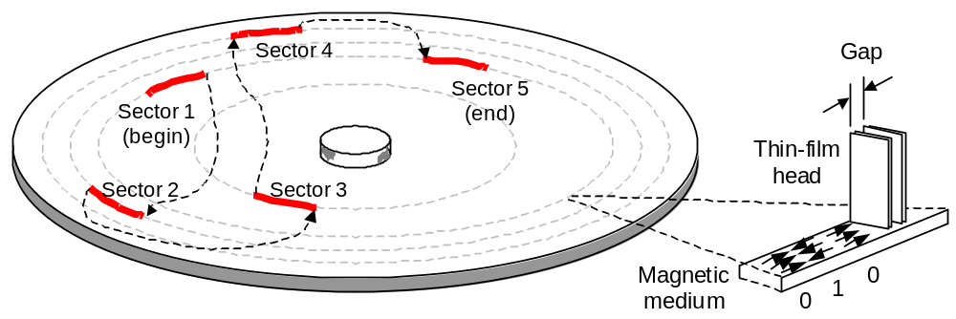
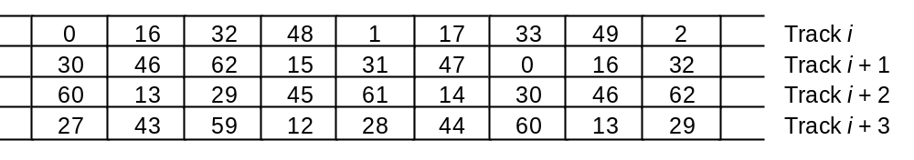
19.2 Organizing Data on Disk
Fig. 19.2 Magnetic recording along the tracks and the read/write head.
Fig. 19.3 Logical numbering of sectors on several adjacent tracks.
Nov. 2014
Computer Architecture, Memory System Design
Slide <number>

Slide 50
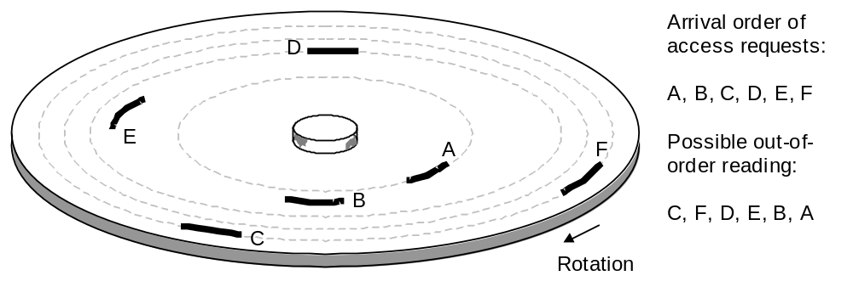
19.3 Disk Performance
Seek time = a + b(c – 1) + β(c – 1)^{1/2}
Average rotational latency = (30 / rpm) s = (30 000 / rpm) ms
Fig. 19.4 Reducing average seek time and rotational latency by performing disk accesses out of order.
Nov. 2014
Computer Architecture, Memory System Design
Slide <number>

Slide 51
19.4 Disk Caching
Same idea as processor cache: bridge main-disk speed gap
Read/write an entire track with each disk access:
“Access one sector, get 100s free,” hit rate around 90%
Disks listed in Table 19.1 have buffers from 1/8 to 16 MB
Rotational latency eliminated; can start from any sector
Need back-up power so as not to lose changes in disk cache
(need it anyway for head retraction upon power loss)
Placement options for disk cache
In the disk controller:
Suffers from bus and controller latencies even for a cache hit
Closer to the CPU:
Avoids latencies and allows for better utilization of space
Intermediate or multilevel solutions
Nov. 2014
Computer Architecture, Memory System Design
Slide <number>

Slide 52
19.5 Disk Arrays and RAID
The need for high-capacity, high-throughput secondary (disk) memory
Processor speed | RAM size | Disk I/O rate | Number of disks | Disk capacity | Number of disks
1 GIPS | 1 GB | 100 MB/s | 1 | 100 GB | 1
1 TIPS | 1 TB | 100 GB/s | 1000 | 100 TB | 100
1 PIPS | 1 PB | 100 TB/s | 1 Million | 100 PB | 100 000
1 EIPS | 1 EB | 100 PB/s | 1 Billion | 100 EB | 100 Million
Amdahl’s rules of thumb for system balance
1 RAM byte
for each IPS
1 I/O bit per sec
for each IPS
100 disk bytes
for each RAM byte
Nov. 2014
Computer Architecture, Memory System Design
Slide <number>

Slide 53
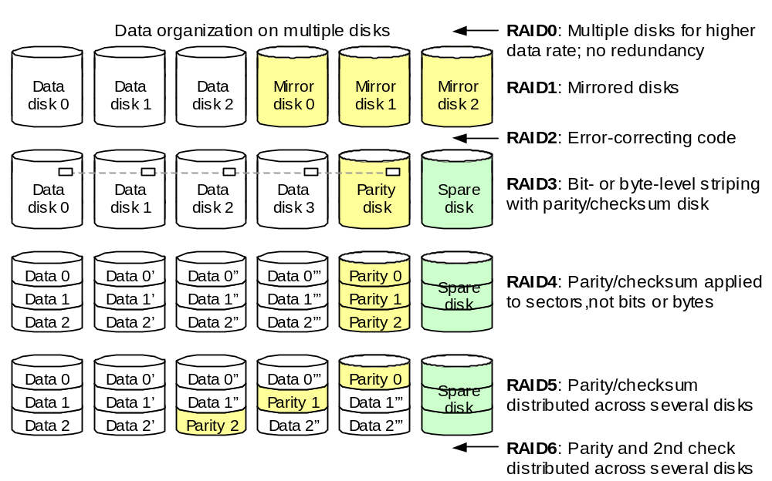
Redundant Array of Independent Disks (RAID)
A
B
C
D
P
A ⊕ B ⊕ C ⊕ D ⊕ P = 0 →
B = A ⊕ C ⊕ D ⊕ P
Fig. 19.5 RAID levels 0-6, with a simplified view of data organization.
Nov. 2014
Computer Architecture, Memory System Design
Slide <number>

Slide 54
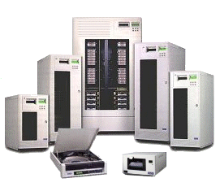
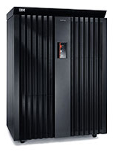
RAID Product Examples
IBM ESS Model 750
Nov. 2014
Computer Architecture, Memory System Design
Slide <number>

Slide 55
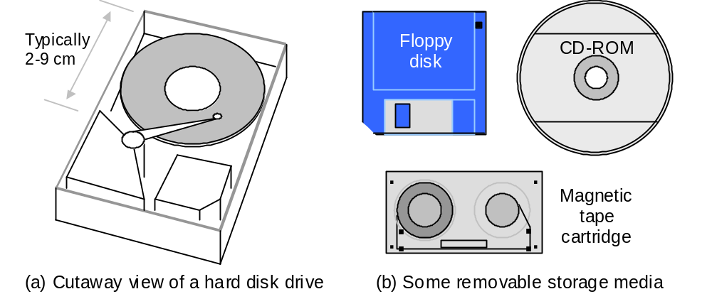

19.6 Other Types of Mass Memory
Fig. 3.12 Magnetic and optical disk memory units.
Flash drive
Thumb drive
Travel drive
Nov. 2014
Computer Architecture, Memory System Design
Slide <number>

Slide 56
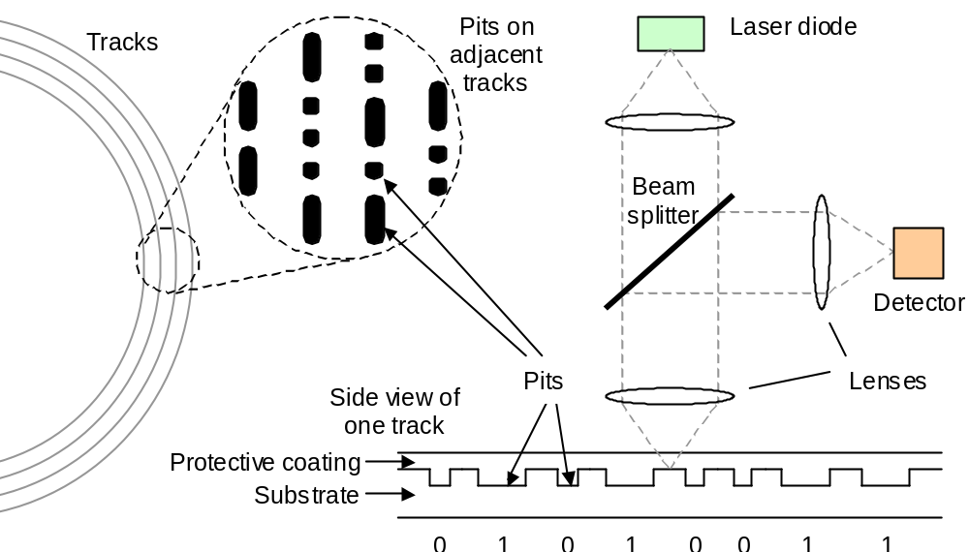
Optical Disks
Spiral, rather than concentric, tracks
Fig. 19.6 Simplified view of recording format and access mechanism for data on a CD-ROM or DVD-ROM.
Nov. 2014
Computer Architecture, Memory System Design
Slide <number>

Slide 57
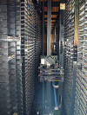
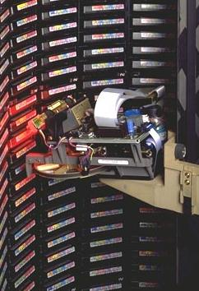
Automated Tape Libraries
Nov. 2014
Computer Architecture, Memory System Design
Slide <number>

Slide 58
20 Virtual Memory and Paging
Managing data transfers between main & mass is cumbersome
  Virtual memory automates this process
  Key to virtual memory’s success is the same as for cache
Topics in This Chapter
20.1 The Need for Virtual Memory
20.2 Address Translation in Virtual Memory
20.3 Translation Lookaside Buffer
20.4 Page Placement and Replacement
20.5 Main and Mass Memories
20.6 Improving Virtual Memory Performance
Nov. 2014
Computer Architecture, Memory System Design
Slide <number>

Slide 59
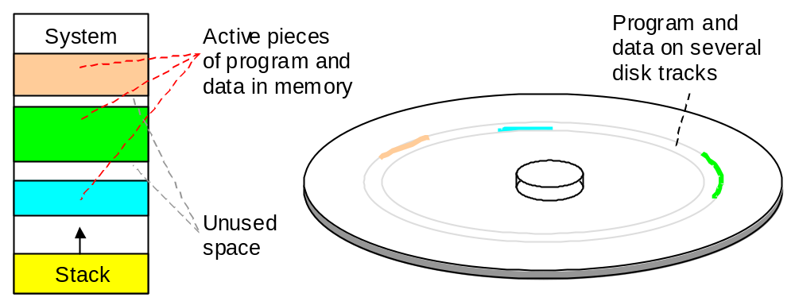
20.1 The Need for Virtual Memory
Fig. 20.1 Program segments in main memory and on disk.
Nov. 2014
Computer Architecture, Memory System Design
Slide <number>

Slide 60
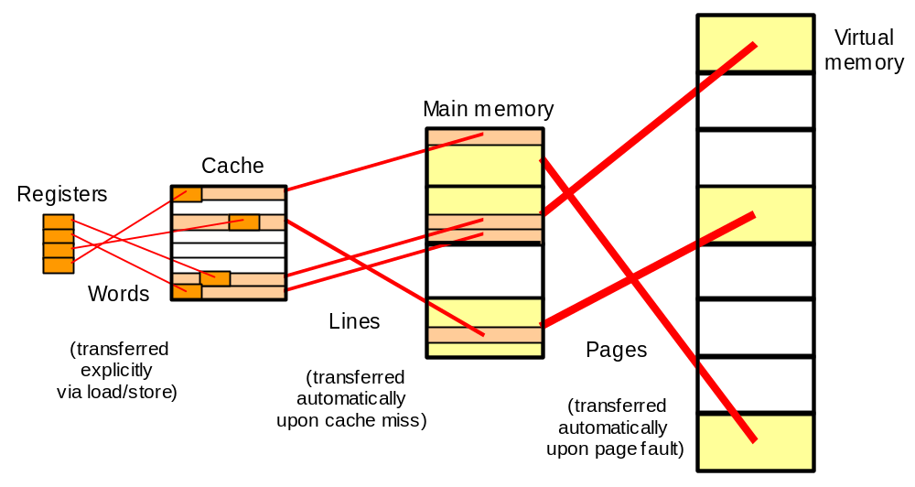
Memory Hierarchy: The Big Picture
Fig. 20.2 Data movement in a memory hierarchy.
Nov. 2014
Computer Architecture, Memory System Design
Slide <number>

Slide 61
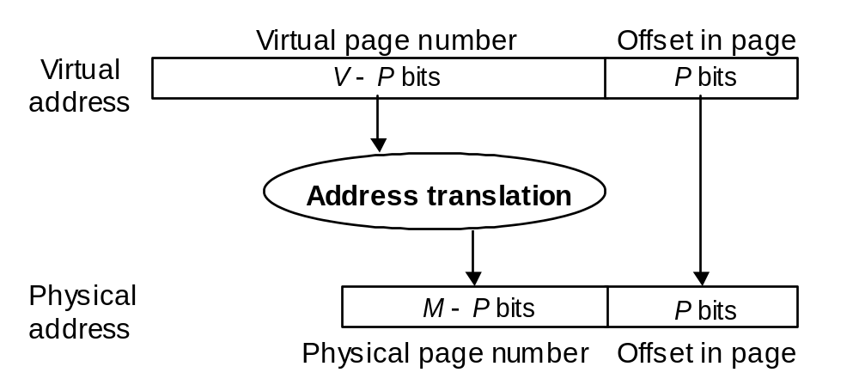
20.2 Address Translation in Virtual Memory
Fig. 20.3 Virtual-to-physical address translation parameters.
Example 20.1
Determine the parameters in Fig. 20.3 for 32-bit virtual addresses, 4 KB pages, and 128 MB byte-addressable main memory.
Solution: Physical addresses are 27 b, byte offset in page is 12 b;
thus, virtual (physical) page numbers are 32 – 12 = 20 b (15 b)
Nov. 2014
Computer Architecture, Memory System Design
Slide <number>

Slide 62
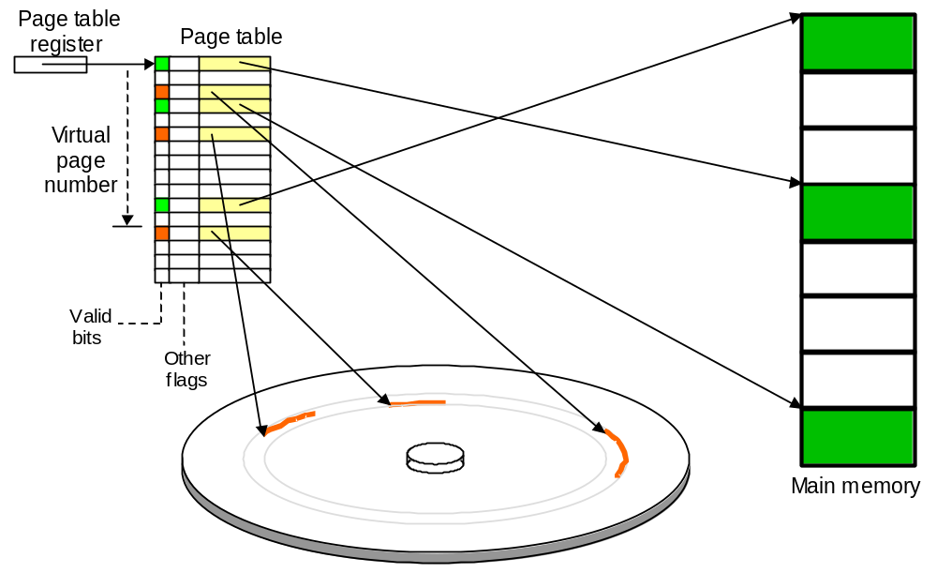
Page Tables and Address Translation
Fig. 20.4 The role of page table in the virtual-to-physical address translation process.
Nov. 2014
Computer Architecture, Memory System Design
Slide <number>

Slide 63

Protection and Sharing in Virtual Memory
0
1
2
3
4
5
6
7
0
1
2
3
4
5
6
7
Fig. 20.5 Virtual memory as a facilitator of sharing and memory protection.
Nov. 2014
Computer Architecture, Memory System Design
Slide <number>

Slide 64
The Latency Penalty of Virtual Memory
Virtual address
Memory access 2
Physical address
Memory access 1
Fig. 20.4
Nov. 2014
Computer Architecture, Memory System Design
Slide <number>

Slide 65

20.3 Translation Lookaside Buffer
Program page in virtual memory
lw $t0,0($s1)
addi $t1,$zero,0
L: add $t1,$t1,1
beq $t1,$s2,D
add $t2,$t1,$t1
add $t2,$t2,$t2
add $t2,$t2,$s1
lw $t3,0($t2)
slt $t4,$t0,$t3
beq $t4,$zero,L
addi $t0,$t3,0
j L
D: ...
All instructions on this page have the same virtual page address
and thus entail
the same translation
Fig. 20.6 Virtual-to-physical address translation by a TLB and how the resulting physical address is used to access the cache memory.
Nov. 2014
Computer Architecture, Memory System Design
Slide <number>

Slide 66
Address Translation via TLB
Example 20.2
An address translation process converts a 32-bit virtual address to a 32-bit physical address. Memory is byte-addressable with 4 KB pages. A 16-entry, direct-mapped TLB is used. Specify the components of the virtual and physical addresses and the width of the various TLB fields.
Solution
Virtual
Page number
20
12
TLB word width =
16-bit tag +
20-bit phys page # +
1 valid bit +
Other flags
≥ 37 bits
16
4
Tag
TLB
index
16-entry
TLB
20
12
Fig. 20.6
Nov. 2014
Computer Architecture, Memory System Design
Slide <number>

Slide 67

Virtual- or Physical-Address Cache?
TLB access may form an extra pipeline stage, thus the penalty in throughput can be insignificant
Cache may be accessed with part of address that is common between virtual and physical addresses
Fig. 20.7 Options for where virtual-to-physical address translation occurs.
Nov. 2014
Computer Architecture, Memory System Design
Slide <number>

Slide 68
20.4 Page Replacement Policies
Least-recently used (LRU) policy
Implemented by maintaining a stack
Pages → A B A F B E A
LRU stack
MRU D A B A F B E A
B D A B A F B E
E B D D B A F B
LRU C E E E D D A F
Nov. 2014
Computer Architecture, Memory System Design
Slide <number>

Slide 69

Approximate LRU Replacement Policy
Least-recently used policy: effective, but hard to implement
Approximate versions of LRU are more easily implemented
Clock policy: diagram below shows the reason for name
Use bit is set to 1 whenever a page is accessed
Page slot 0
Page slot 7
Page slot 1
Fig. 20.8 A scheme for the approximate implementation of LRU .
Nov. 2014
Computer Architecture, Memory System Design
Slide <number>

Slide 70

LRU Is Not Always the Best Policy
Example 20.2
Computing column averages for a 17 × 1024 table; 16-page memory
for j = [0 … 1023] {
temp = 0;
for i = [0 … 16]
temp = temp + T[i][j]
print(temp/17.0); }
Evaluate the page faults for row-major and column-major storage.
Solution
Fig. 20.9 Pagination of a 17×1024 table with row- or column-major storage.
Nov. 2014
Computer Architecture, Memory System Design
Slide <number>

Slide 71

20.5 Main and Mass Memories
Working set of a process, W(t, x): The set of pages accessed over the last x instructions at time t
Principle of locality ensures that the working set changes slowly
Fig. 20.10 Variations in the size of a program’s working set.
Nov. 2014
Computer Architecture, Memory System Design
Slide <number>

Slide 72
20.6 Improving Virtual Memory Performance
Table 20.1 Memory hierarchy parameters and their effects on performance
Parameter variation | Potential advantages | Possible disadvantages
Larger main or cache size | Fewer capacity misses | Longer access time
Larger pages or longer lines | Fewer compulsory misses (prefetching effect) | Greater miss penalty
Greater associativity (for cache only) | Fewer conflict misses | Longer access time
More sophisticated replacement policy | Fewer conflict misses | Longer decision time, more hardware
Write-through policy (for cache only) | No write-back time penalty, easier write-miss handling | Wasted memory bandwidth, longer access time
Nov. 2014
Computer Architecture, Memory System Design
Slide <number>

Slide 73

Impact of Technology on Virtual Memory
Fig. 20.11 Trends in disk, main memory, and CPU speeds.
Nov. 2014
Computer Architecture, Memory System Design
Slide <number>

Slide 74

Performance Impact of the Replacement Policy
Fig. 20.12 Dependence of page faults on the number of pages allocated and the page replacement policy
Nov. 2014
Computer Architecture, Memory System Design
Slide <number>

Slide 75
Summary of Memory Hierarchy
Cache memory: provides illusion of very high speed
Main memory: reasonable cost, but slow & small
Virtual memory: provides illusion of
very large size
Locality makes the illusions work
Fig. 20.2 Data movement in a memory hierarchy.
Nov. 2014
Computer Architecture, Memory System Design
Slide <number>

